Slide 1
DIAGNOSIS OF PEYRONIE’S DISEASE AND SHEAR WAVE ELASTOSONOGRAPHY OF THE PENIS: NEW NON-INVASIVE METHOD.
relatore
Dott. Francesco Trama
Francesco Trama, Ester Illiano, Antonio Ruffo, Fabrizio Iacono , Elisabetta Costantini.
Clinica urologica ad indirizzo uroginecologico e andrologico
AOSP Santa Maria di Terni – Università di Perugia.
Dipartimento di Neuroscienze e Scienze Riproduttive ed Odontostomatologiche.
Azienda Ospedaliera Universitaria Policlinico “Federico II” di Napoli.

Slide 2
OBJECTIVE OF THE STUDY
it is to identify a possible relationship between penile rigidity and pain in erection and subsequent appearance of typical plaques de La Peyronie's disease.
We have used a Shear Wave Elastosonography of corpora cavernosa for demonstrate the presence of penile fibrosity (expressed at tissue level as stiffness) typical of the early stages of La Peyronie's disease in patients with erectile pain.

Slide 3
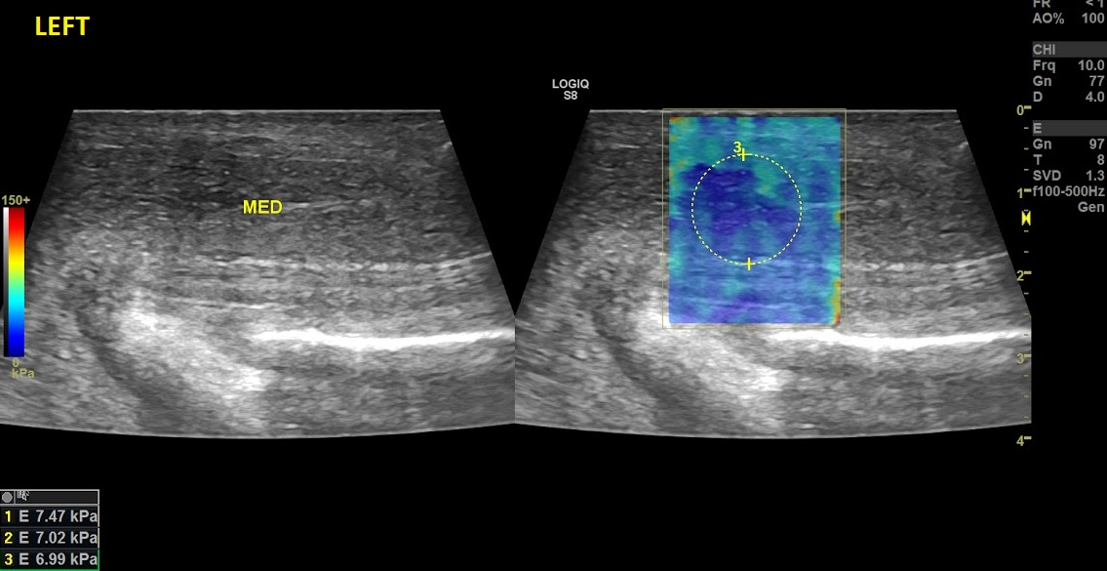
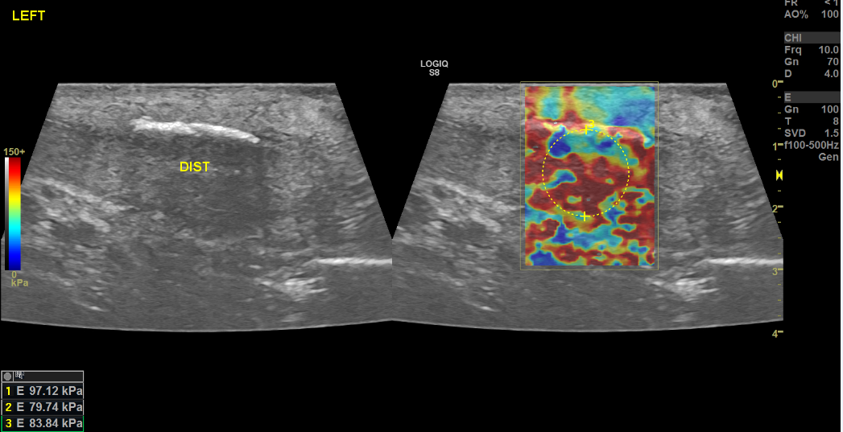
METHODS
This was a prospective study
Exlusion Criteria:
diabetes, previous pelvic surgery, patients who had taken PDE5i less than three months ago, or who had previously been treated for La Peyronie's disease.
Inclusion criteria:
subjects with erectile pain;
subjects with palpable or visible plaque on B Mode ultrasound.
All patients underwent shear wave Elastosonography of the corpora cavernosa and B – Mode ultrasound. they compilated VAS questionnaire regarding pain in erection

Slide 4
RESULTS
85 patients were recruited
The results obtained reveal that the baseline VAS score correlates positively with the rigidity of the corpora cavernosa expressed in kPa (according to Young's module) obtained by SWE(p< 0.05).
There was no statistically significant correlation (p=0.09) between the presence of hyperecogenic plaques on B-mode ultrasound and the VAS score.
At 6 months, there was a statistically significant increase in the rigidity of both corpora cavernosa respect to baseline (p < .05) with a significant decrease in the VAS score with respect to baseline (p< 0.04).
In addition, there was a positive correlation between patients with a score >28kPa (expressed as an average of both corpora cavernosa) and the appearance of hyperechogenic plaques on ultrasound B - mode ( p< 0.03).

Slide 5
CONCLUSIONS
Shear Wave Elastosonography of corpora cavernosa can be used in daily clinical practice to make an early and non-invasive diagnosis of La Peyronie's disease.
In this way patients could receive early diagnosis and specific therapies in order to slow down the development of the disease.

